Slide 1


Relevance Vector Machines
Machine Learning – Spring 2018
Paul Gader

Slide 2
Relevance Vector Machine
Bayesian Linear Regression
Gaussian Likelihood and Prior
Sparsity Achieved with Prior Hyper-Parameters
Bayesian Linear Regression with Kernels

Slide 3
RVM: Linear Regression (not fully general)
Linear Model
Likelihood Function

Slide 4
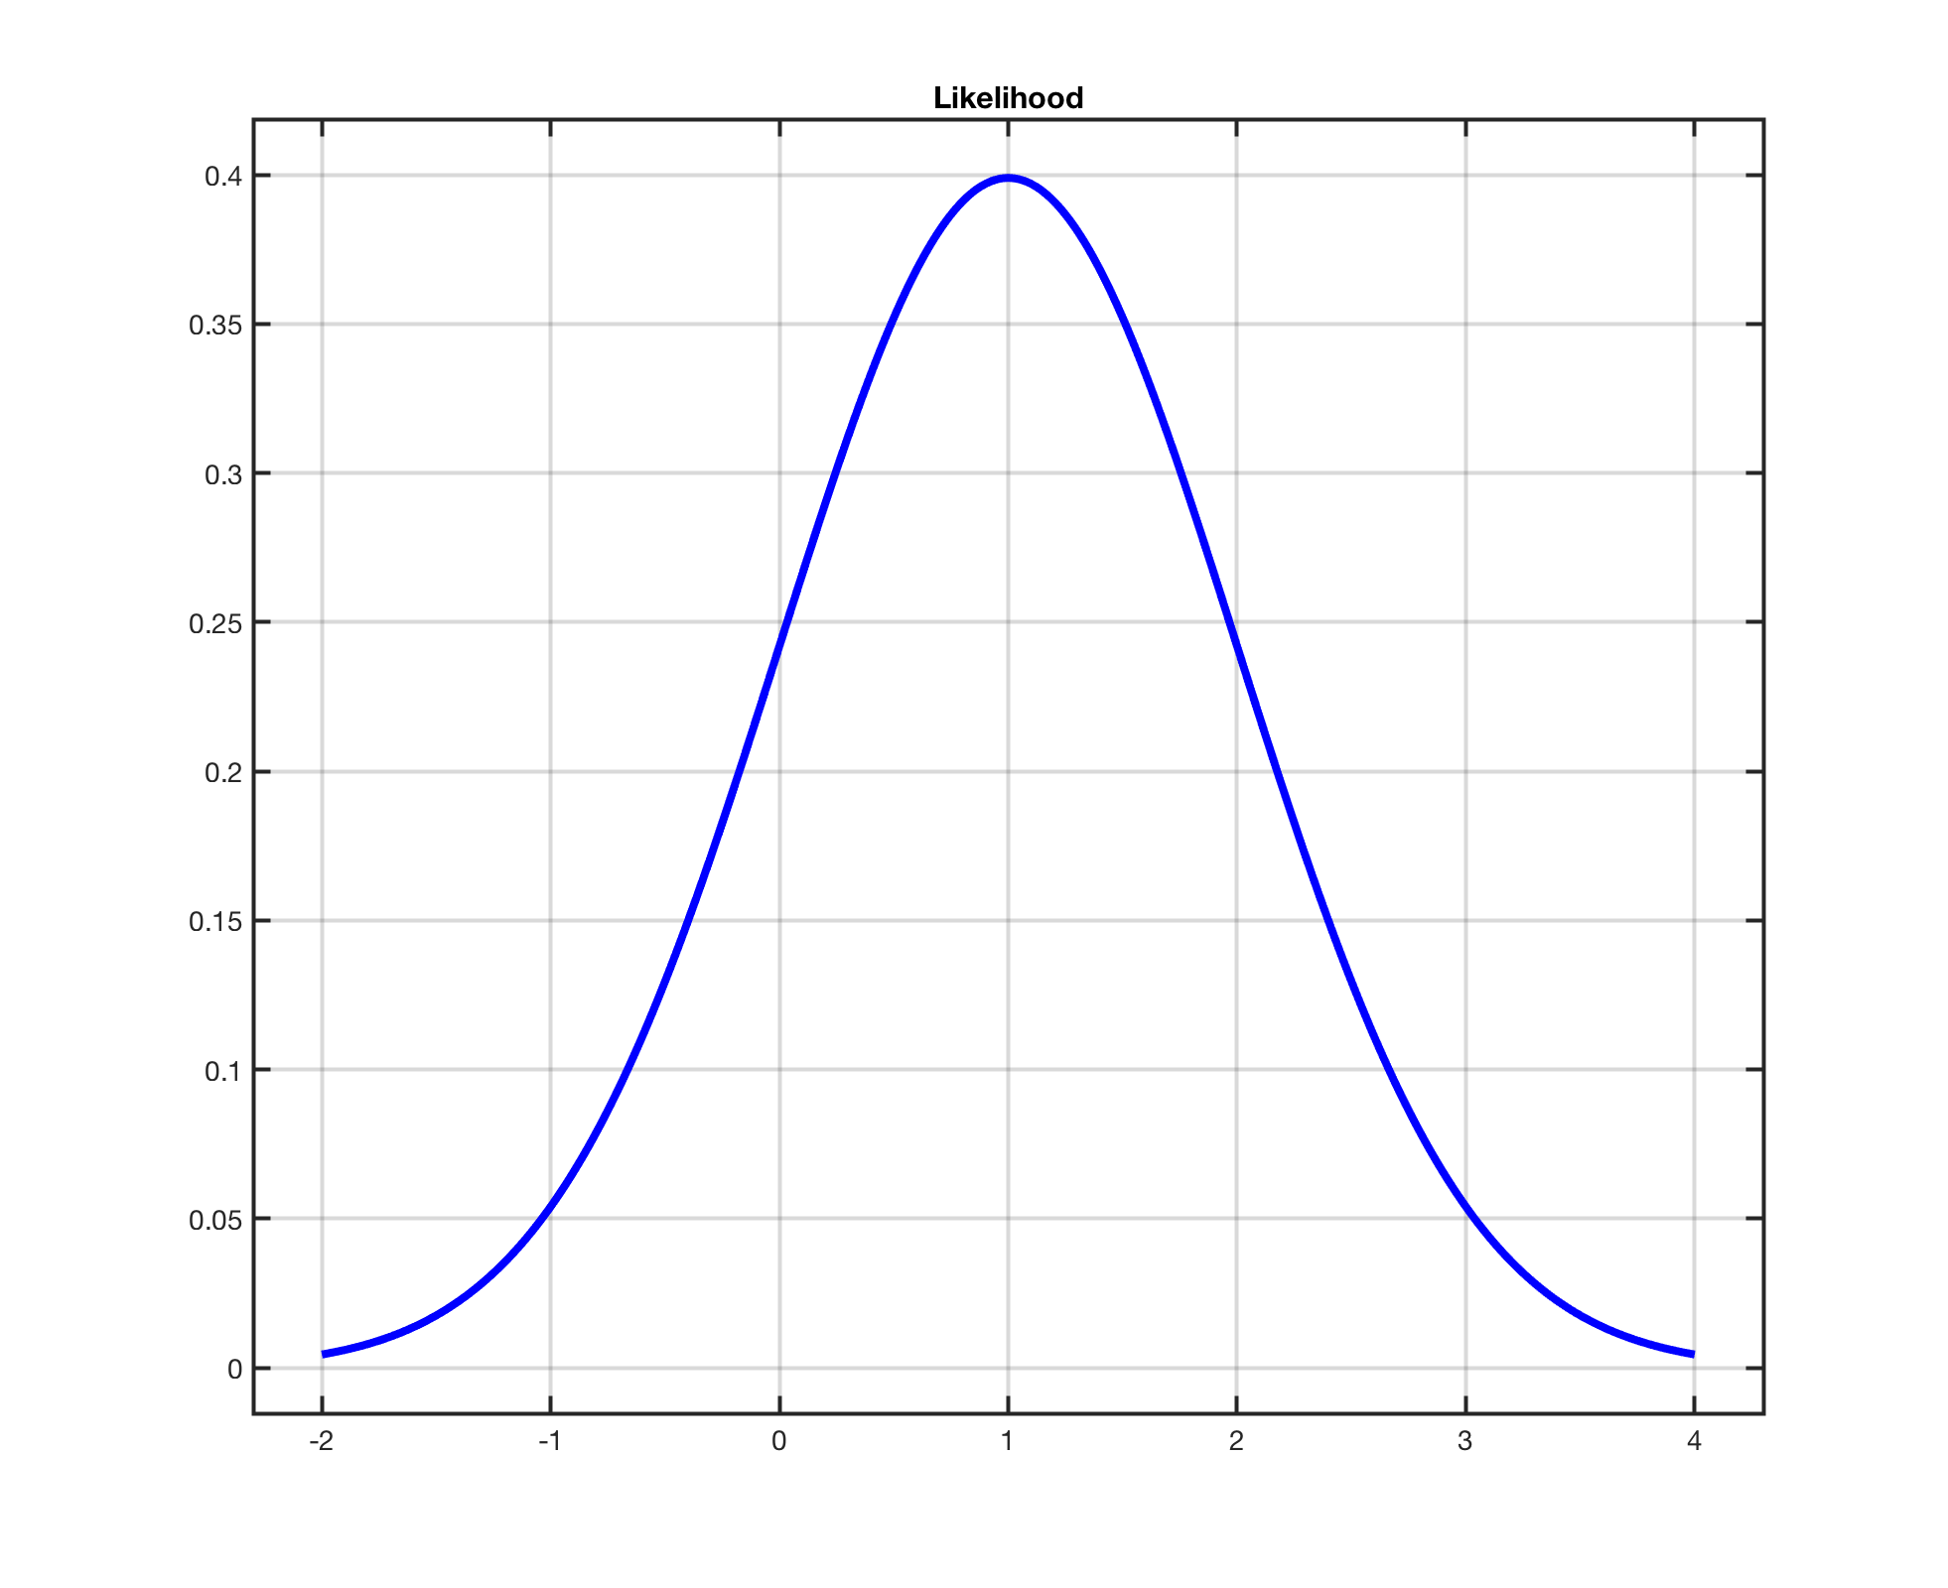
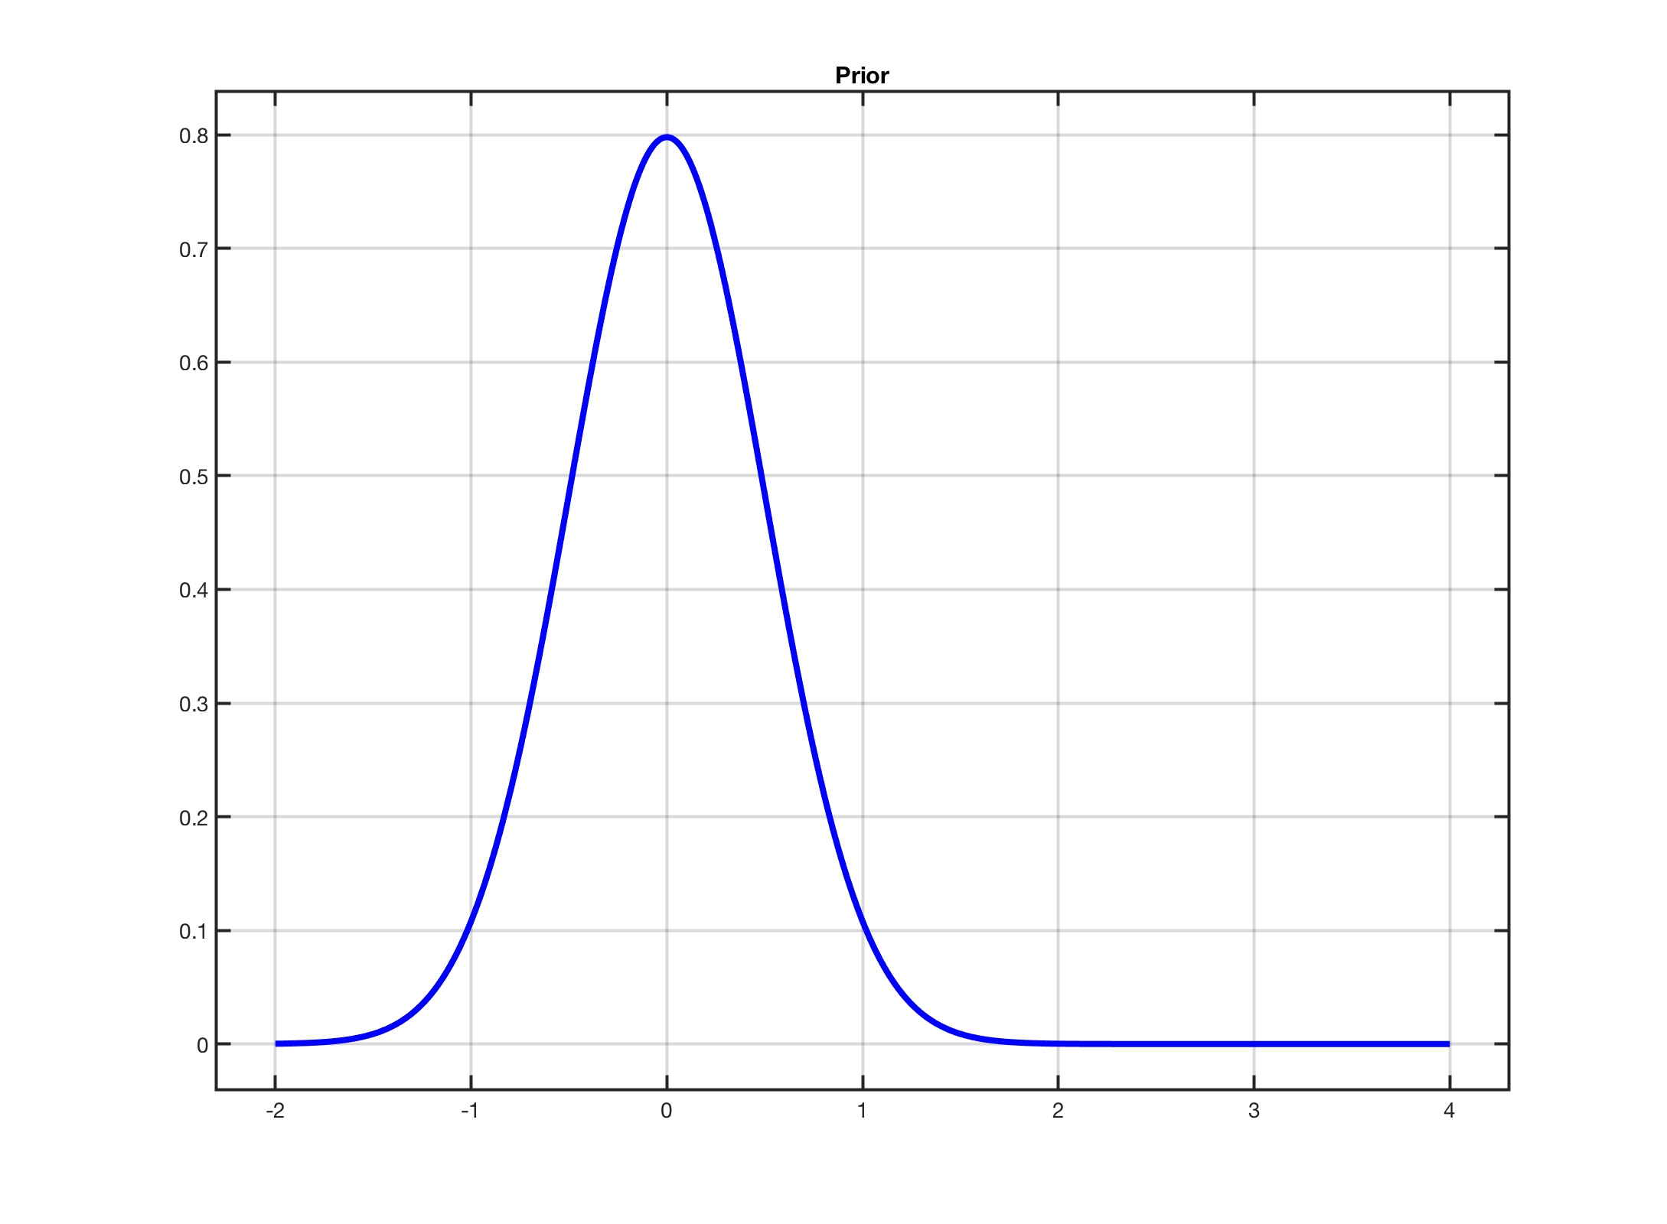
RVM: Bayesian Linear Regression
Gaussian Likelihood & Prior

Slide 5
RVM – Bayesian Linear Regression 2D
Likelihood
Prior

Slide 6
Posterior Facts
Does this look familiar if A = αI ?

Slide 7
RVM: Bayes Linear Regression with Kernels

Slide 8
RVM: Use Kernels

Slide 9
RVM with Kernels: Hyperparameter Learning

Slide 10
RVM and Sparsity

Slide 11
Simple Example

Slide 12
SVM Classifier Maximize Margin between two classes

Slide 13
SVM – Some constraints and KKT conditions => Sparsity

Slide 14
How can we use C to encourage sparsity?

Slide 15
How can we use C to encourage sparsity?

